Slide 1

Machine Learning Image Classification

Slide 2
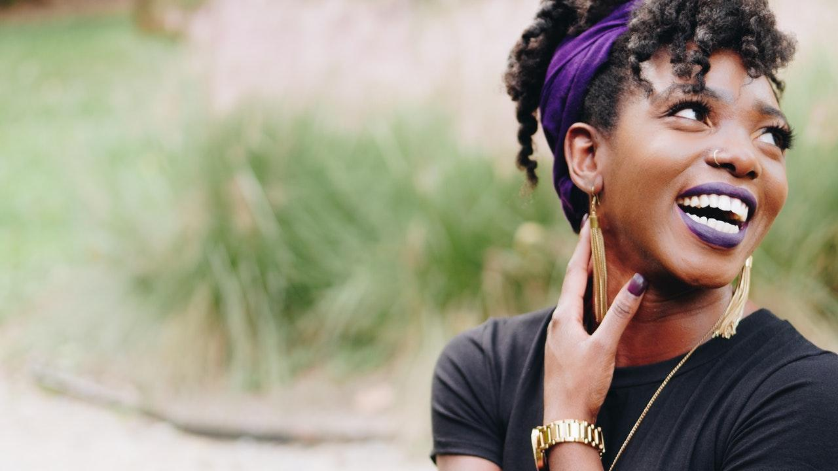
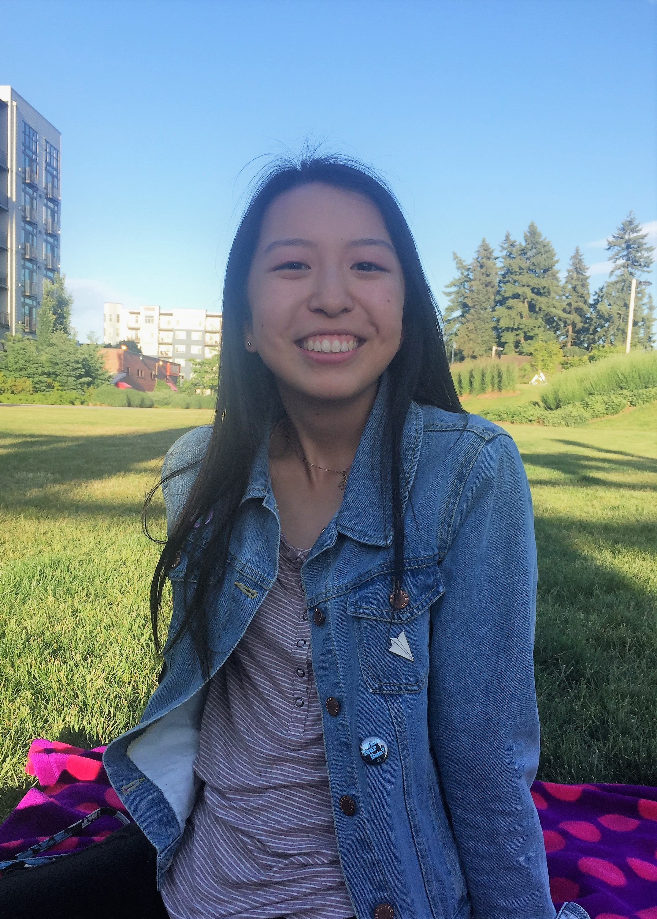


About Me
Julia Dai
MSR High School Intern
Washington University in St. Louis
Class of 2022

Slide 3

Project Overview
Training
Dataset Manipulation
More Training!
Purpose: Recognize the letters of the alphabet in American Sign Language

Slide 4


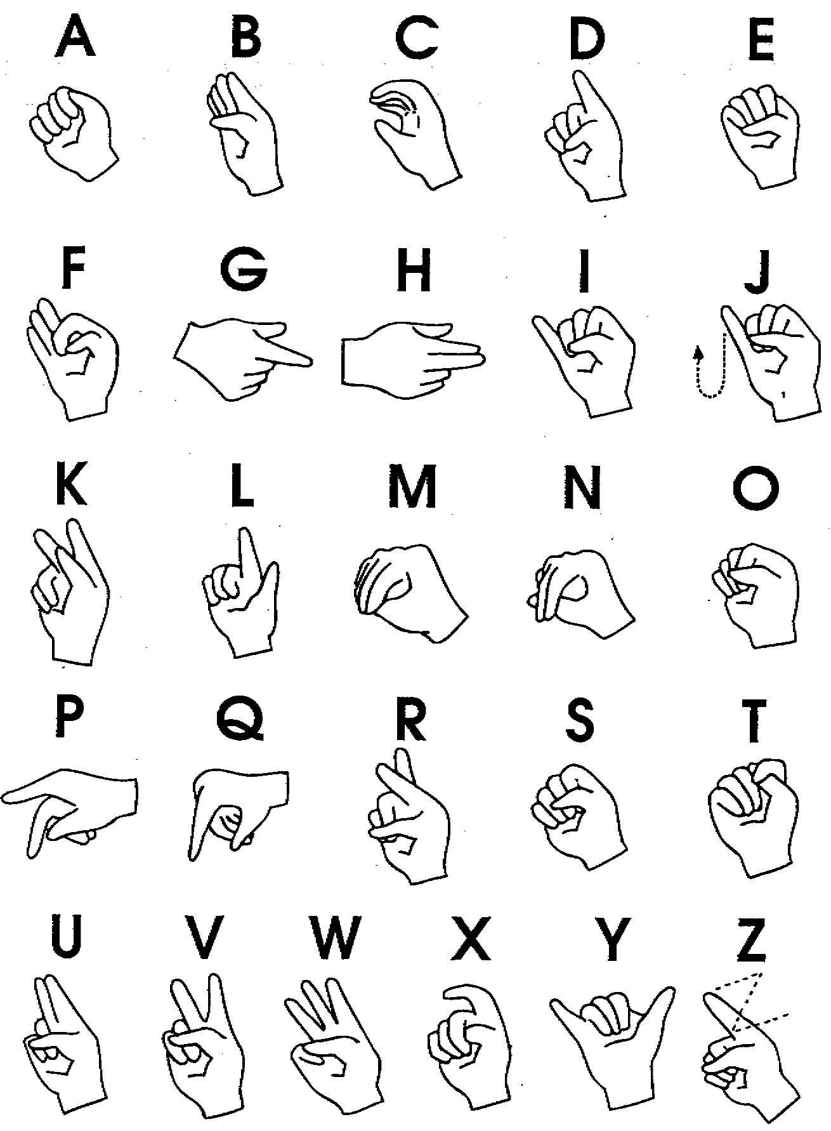
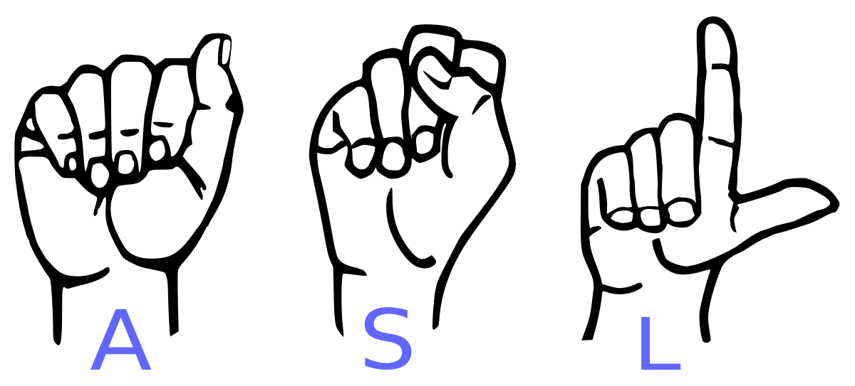
American Sign Language
Language used by the deaf in the United States
Combines hand, torso, face, and arm movement
“Fingerspelling” using the ASL alphabet

Slide 5

1.
Training
Using Pre-trained Models

Slide 6

Convolutional Neural Networks (CNNs)
Deep neural networks, mainly used to analyze images
Consists of layers that pass filters over the image to track features

Slide 7
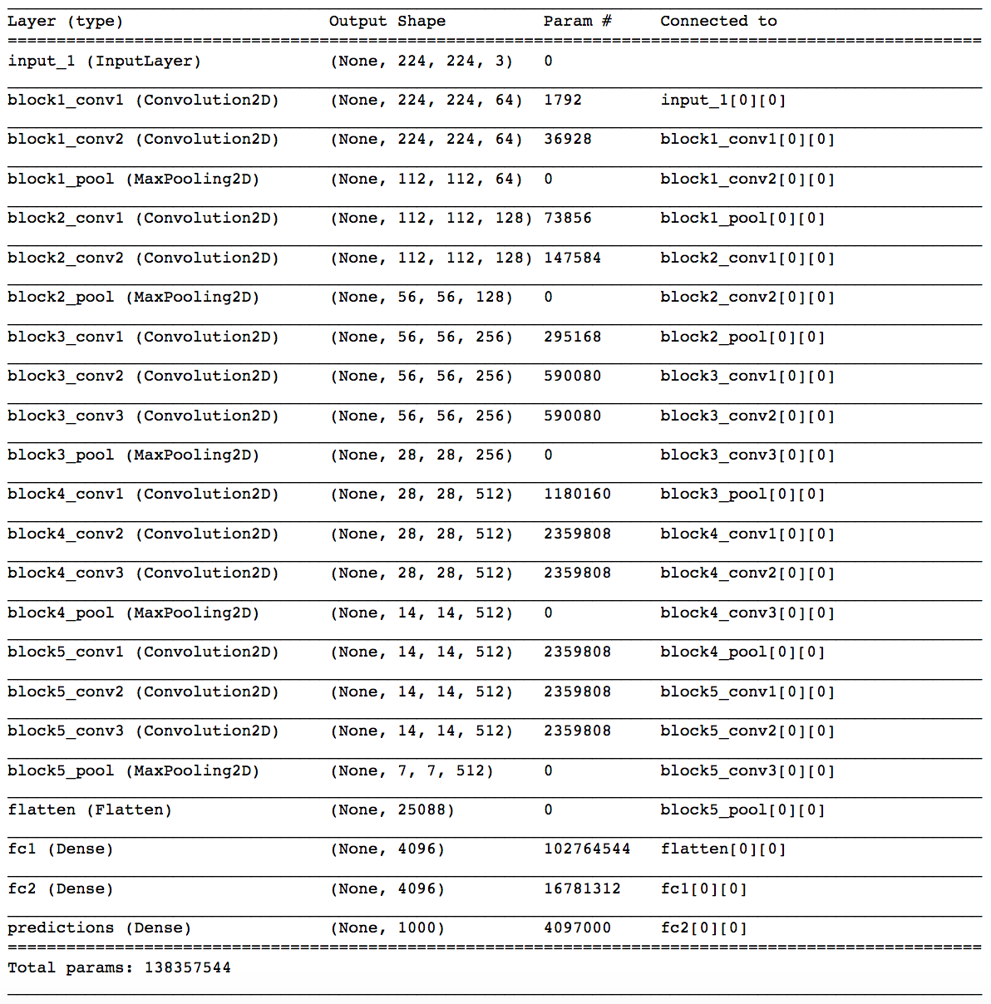

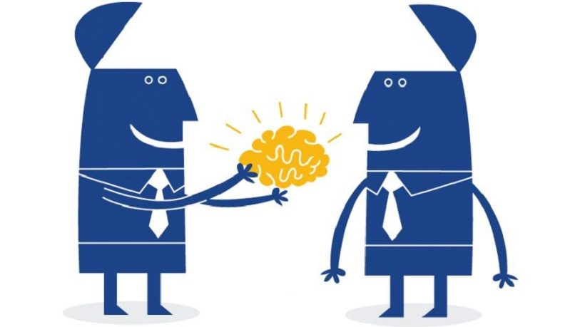
What is transfer learning?
Use a “pre-trained model” to solve a similar problem
Keep model architecture & weights
Fine-tune the model to optimize for a particular task
VGG16

Slide 8
Original Dataset
87,000 images
29 classes
Split into training and validation
Includes 26 letters, “space,” “delete,” and “nothing”
Total success!

Slide 9
Comparing Models
 | Validation Accuracy | Accuracy on my images
DenseNet201 | 97.61% | 72.32%
ResNet50 | 96.4% | 68.75%
Resnet152 | 98.5% | 82.14%

Slide 10
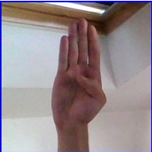
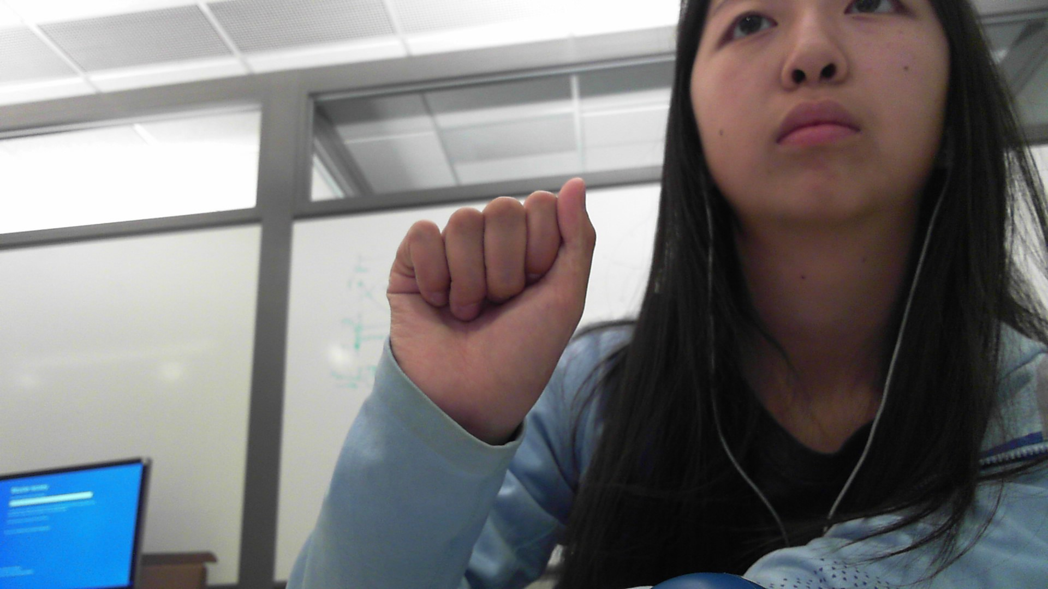
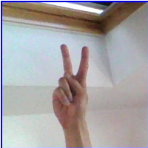
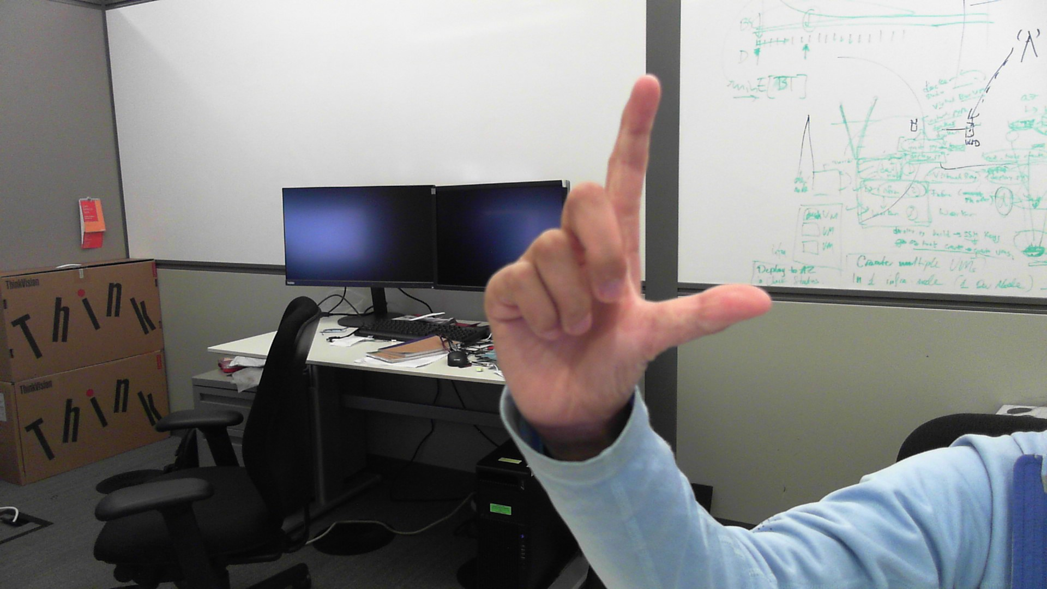
Comparing Images
Original Dataset
My Images

Slide 11
2. Data Manipulation
Creating my own dataset

Slide 12

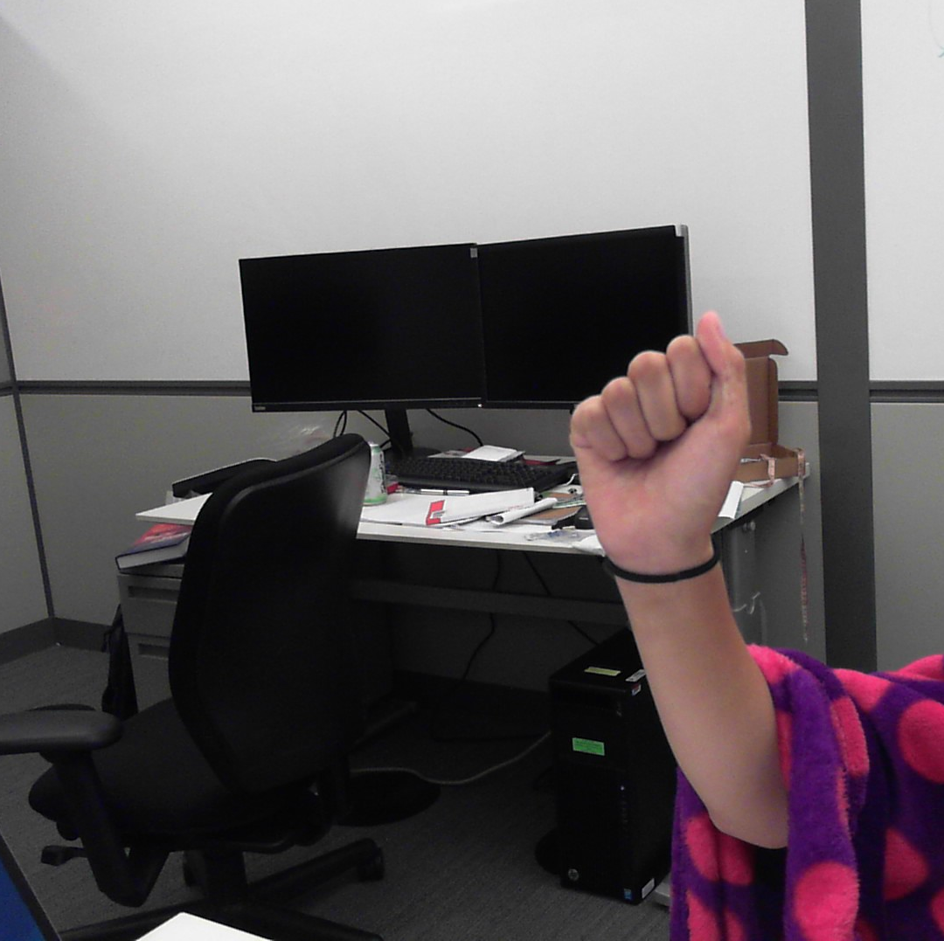
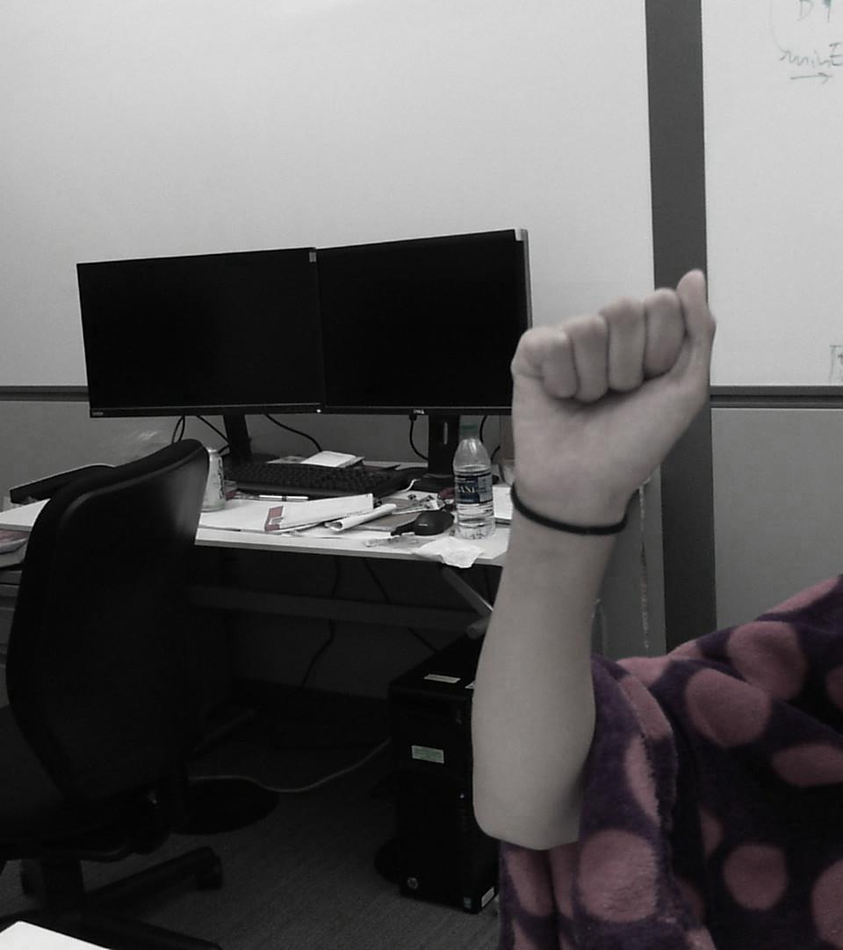
PROCESS
first
second
third
Took ~100 images of each letter / sign for a total of ~3,000 pictures
Used data augmentation to increase dataset size to ~45,000 pictures
Split dataset into training and validation and added it to original dataset

Slide 13
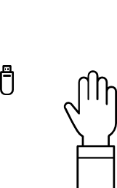
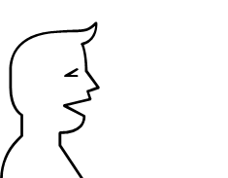
124,700
Total images

Slide 14
3. More Training!
Using the new dataset

Slide 15
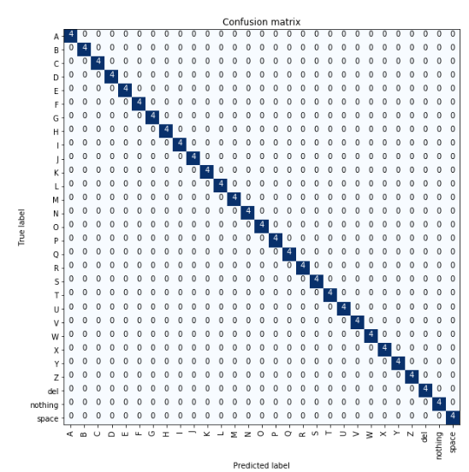
100% accuracy
Trained model to recognize different letters even with abstract backgrounds
Place your screenshot here

Slide 16
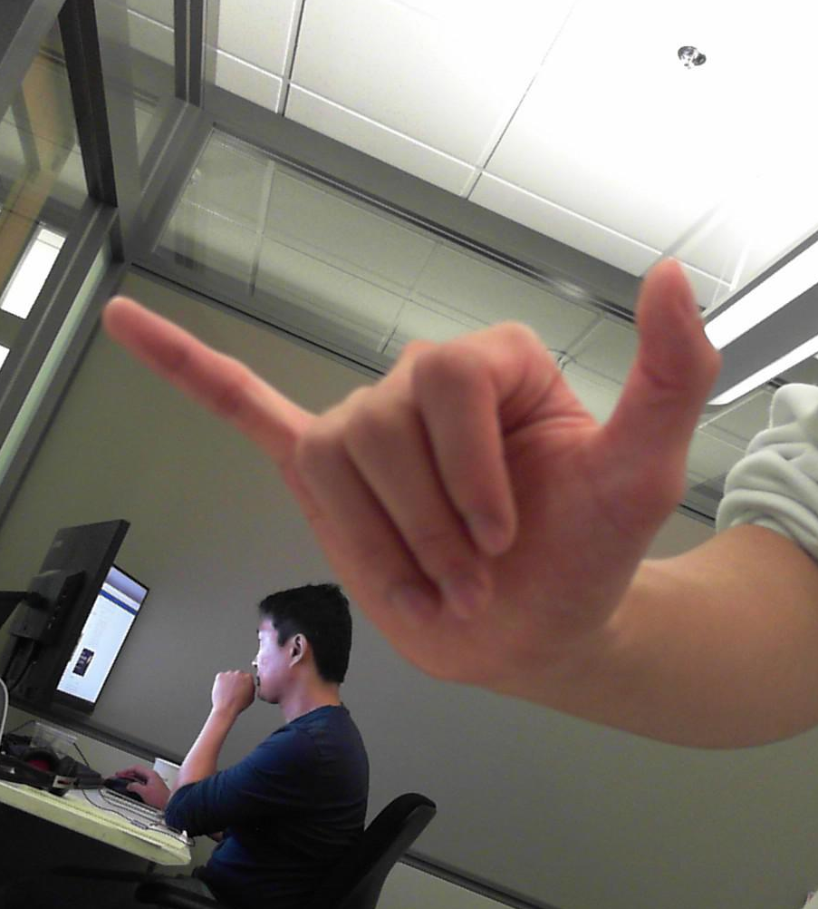
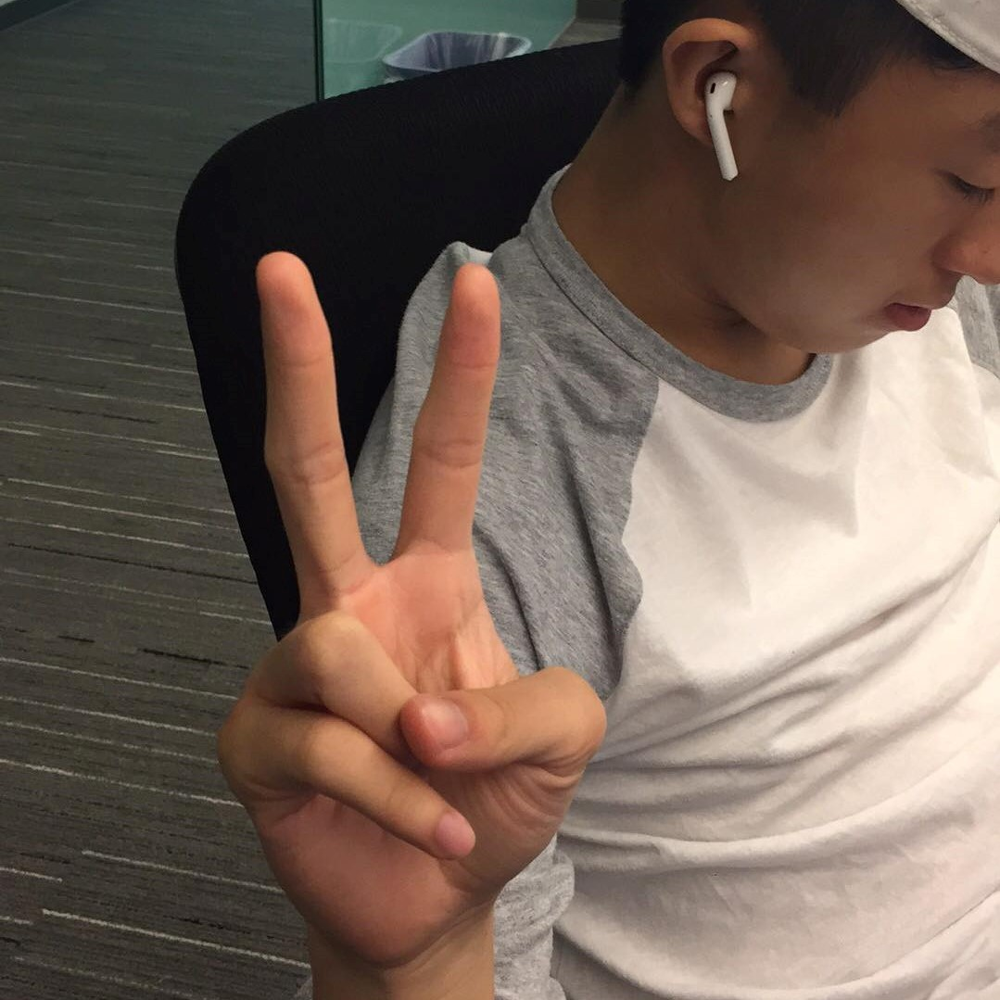
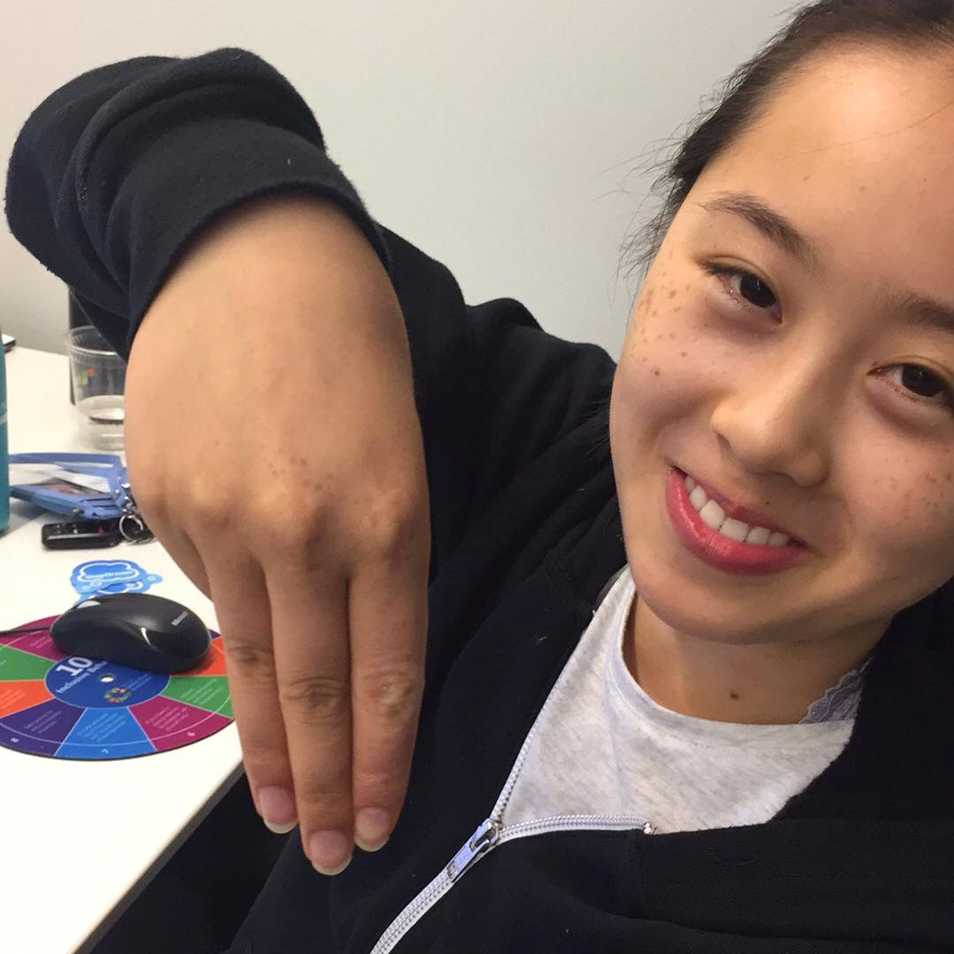

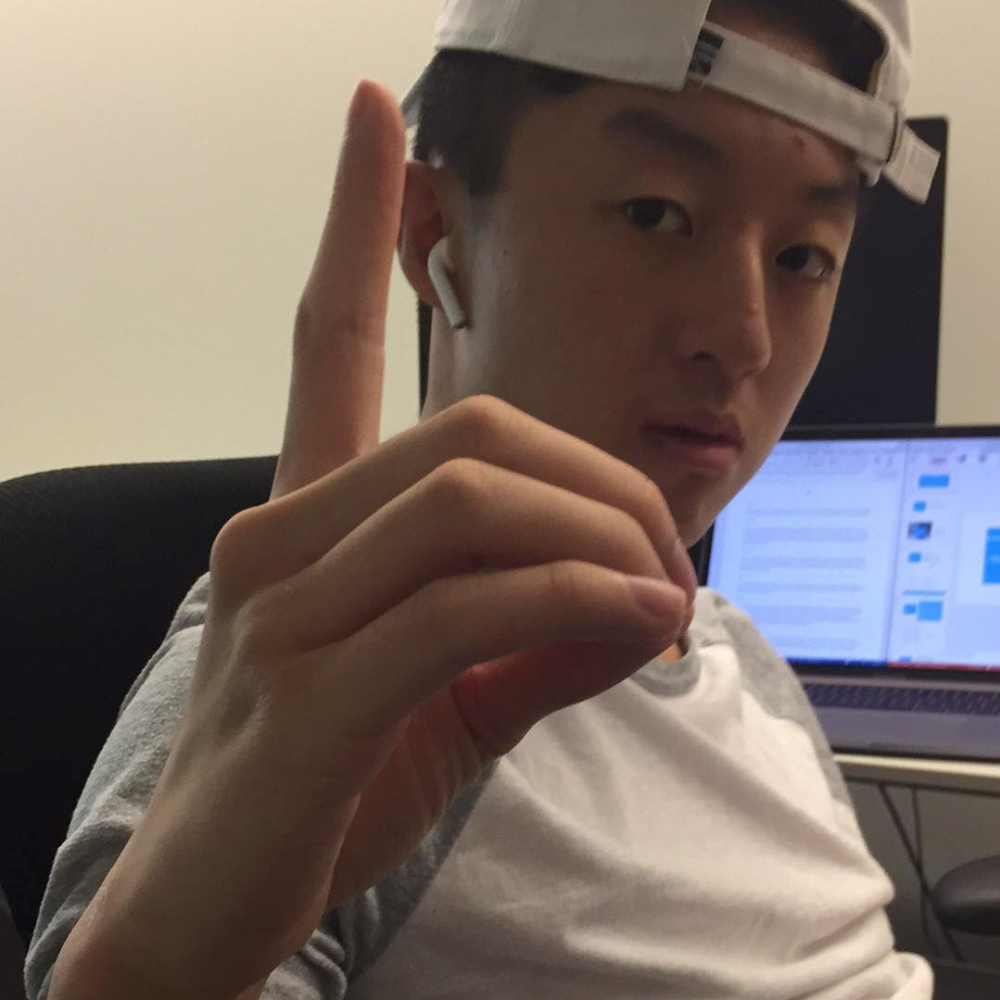
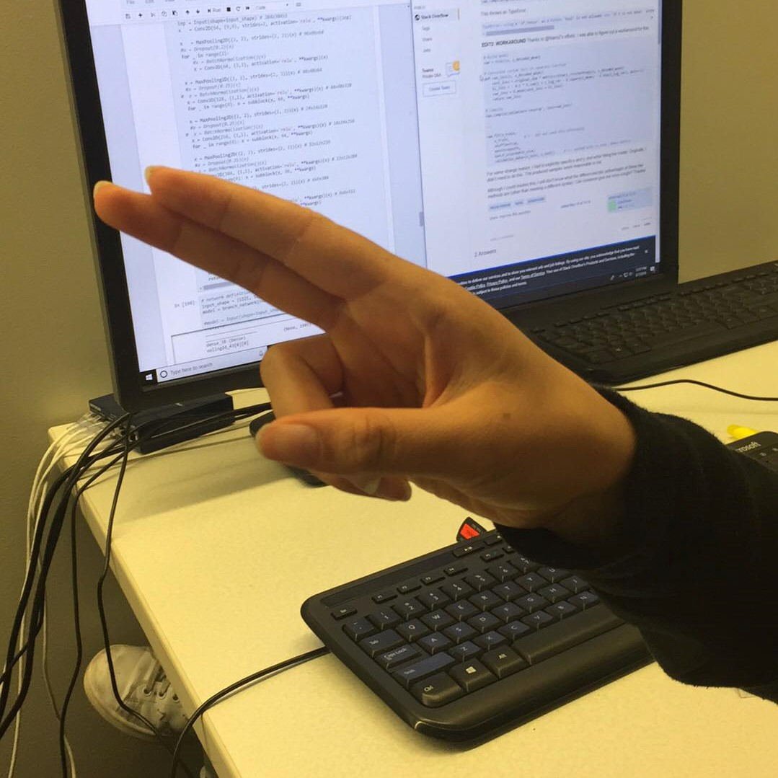
Examples of correctly identified images:
“Y”
“V”
“M”
“L”
“D”
“H”

Slide 17
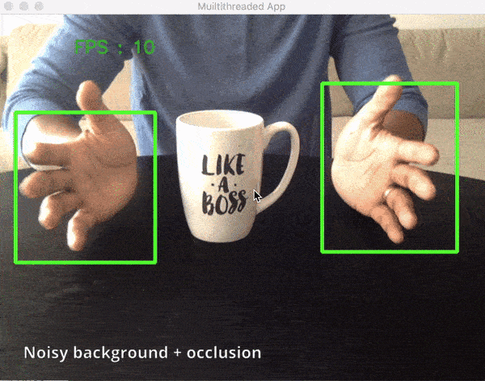
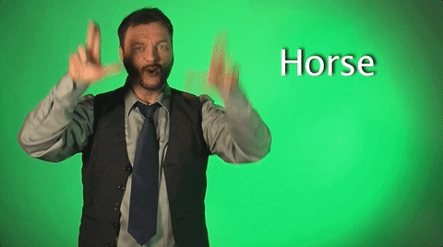
Next Steps…
Live video recognition
Classifying words
Applications
Teach ASL
Serve as a translator between deaf people and others

Slide 18
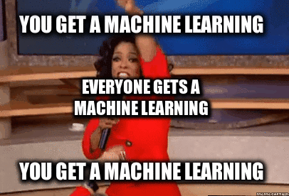
In Conclusion….

Slide 19
CREDITS
Special thanks to Jin Li, Hongzhi Li, and the rest of the team for all your help and mentorship!
Dataset: Created by “Akash,” published on Kaggle website
Images used in PPT:
http://jennymorgan.me/sign-language-coloring-pages/high-tech-american-sign-language-coloring-pages-asl-alphabet-free-4-colouring/
https://www.analyticsvidhya.com/blog/2017/06/transfer-learning-the-art-of-fine-tuning-a-pre-trained-model/
https://medium.freecodecamp.org/an-intuitive-guide-to-convolutional-neural-networks-260c2de0a050

Slide 20
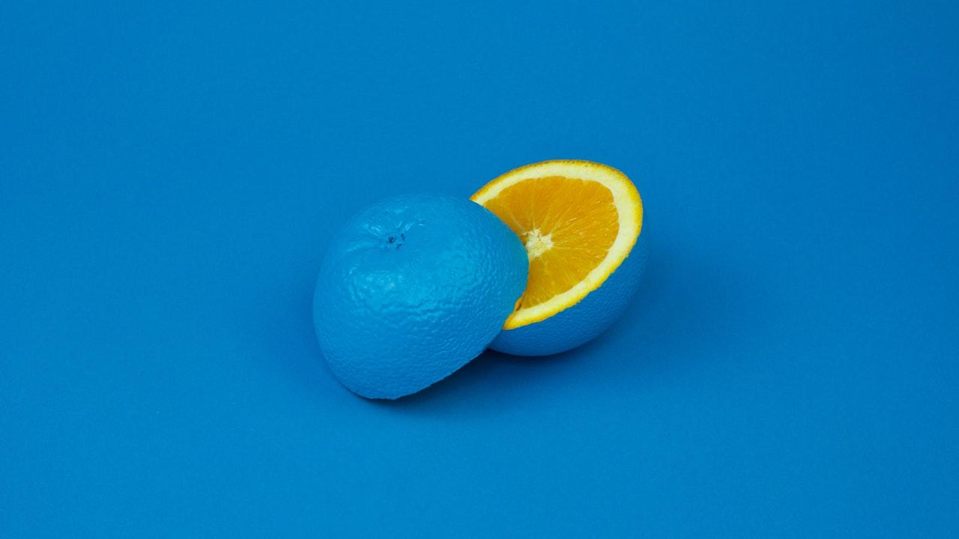
American Sign Language--Alphabet

Slide 21
In Conclusion…

Slide 22
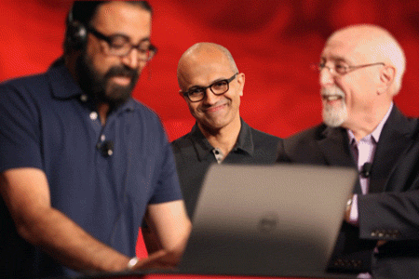
“The thing that's been most exciting in the last five years is this one specialized branch of 'deep neural network' that is fundamentally giving us human perception, whether it is speech or image recognition, and that's just magical to see.“
--Satya Nadella,
CEO of Microsoft

Slide 23
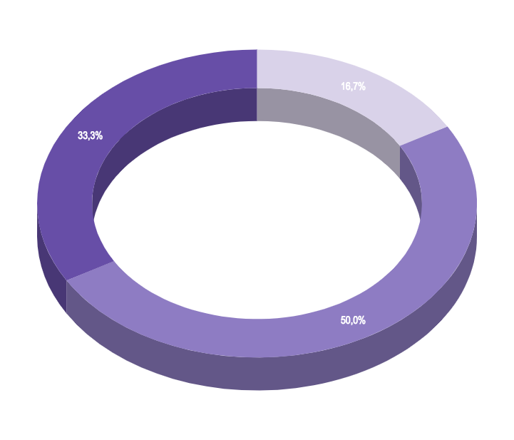
You can insert graphs from Google Sheets

Slide 24
USE DIAGRAMS TO EXPLAIN YOUR IDEAS
01
Vestibulum nec congue tempus
Vestibulum nec congue tempus
Vestibulum nec congue tempus
03
02
Vestibulum nec congue tempus

Slide 25
MAPS
our office

Slide 26
LET’S REVIEW SOME CONCEPTS
Yellow
Is the color of gold, butter and ripe lemons. In the spectrum of visible light, yellow is found between green and orange.
Blue
Is the colour of the clear sky and the deep sea. It is located between violet and green on the optical spectrum.
Red
Is the color of blood, and because of this it has historically been associated with sacrifice, danger and courage.
Yellow
Is the color of gold, butter and ripe lemons. In the spectrum of visible light, yellow is found between green and orange.
Blue
Is the colour of the clear sky and the deep sea. It is located between violet and green on the optical spectrum.
Red
Is the color of blood, and because of this it has historically been associated with sacrifice, danger and courage.

Slide 27
ANDROID PROJECT
Show and explain your web, app or software projects using these gadget templates.
Place your screenshot here

Slide 28
iPHONE PROJECT
Show and explain your web, app or software projects using these gadget templates.
Place your screenshot here

Slide 29
TABLET PROJECT
Show and explain your web, app or software projects using these gadget templates.
Place your screenshot here

Slide 30
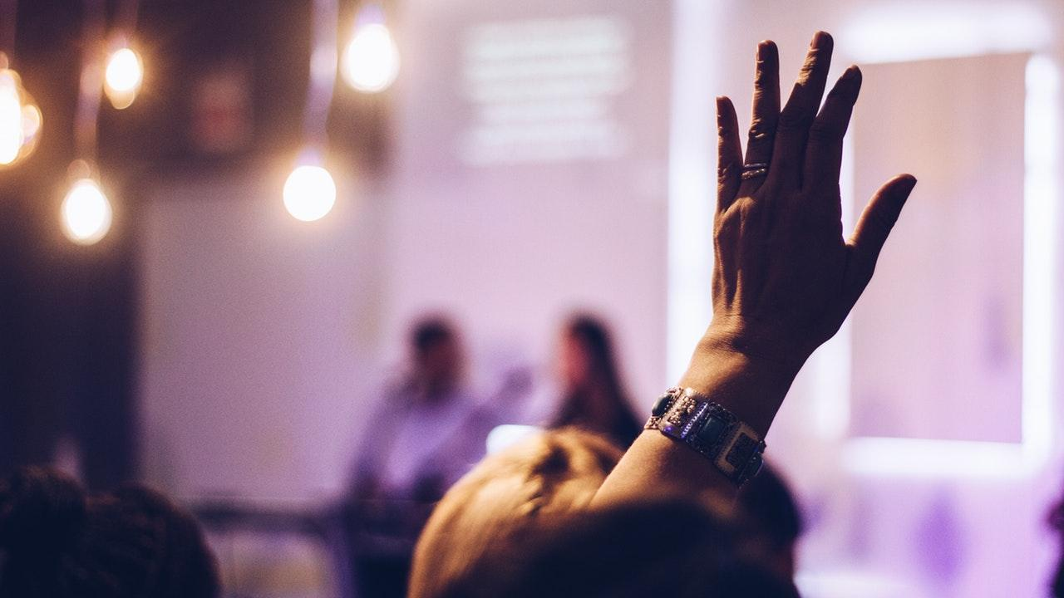
THANKS!
Any questions?
You can find me at:
@username
user@mail.me

Slide 31
PRESENTATION DESIGN
This presentation uses the following typographies and colors:
Titles: Miriam Libre
Body copy: Barlow Light
You can download the fonts on these pages:
https://github.com/MichalSahar/Miriam-Libre/tree/master/fonts/otf
https://www.fontsquirrel.com/fonts/barlow
Indigo #a5b0fe
You don’t need to keep this slide in your presentation. It’s only here to serve you as a design guide if you need to create new slides or download the fonts to edit the presentation in PowerPoint®

Slide 32
EXTRA GRAPHICS

Slide 33
SlidesCarnival icons are editable shapes.
This means that you can:
Resize them without losing quality.
Change line color, width and style.
Isn’t that nice? :)
Examples:

Slide 34
😉
Now you can use any emoji as an icon!
And of course it resizes without losing quality and you can change the color.
How? Follow Google instructions https://twitter.com/googledocs/status/730087240156643328
✋👆👉👍👤👦👧👨👩👪💃🏃💑❤😂😉😋😒😭👶😸🐟🍒🍔💣📌📖🔨🎃🎈🎨🏈🏰🌏🔌🔑 and many more...

